Slide 1
Ethics in Mathematics Curricula from the Beginning
Mathfest August 1 2019
Dr. Patrice Tiffany
Manhattan College
Riverdale, NY

Slide 2
Ethics in a Math classroom?
What special opportunities do we have in a mathematics classroom to introduce ethics?

Slide 3
Much is written on Ethics
at its simplest, a system of moral principles.
is concerned with what is good for individuals and society.
affect how people make decisions and lead their lives.

Slide 4
Ethical Decisions
Ethical decision-making refers to the process of evaluating and choosing among alternatives in a manner consistent with ethical principles.
It is necessary to perceive and eliminate unethical options and select the best ethical alternative.

Slide 5
How can our math courses help our students be prepared to make those ethical decisions?

Slide 6
What are some tools are needed to be able to make any decision?
need to first understand the argument.
need to recognize logic in an argument.
need to be confident enough to question inconsistencies in an argument.
need to be able to pick out the fallacies in the interpretation of data if data is present.

Slide 7
What are some tools are needed to be able to make an ethical decision?
need to first understand the argument.
need to recognize logic in an argument.
need to be confident enough to question inconsistencies in an argument.
need to be able to pick out the fallacies in the interpretation of data if data is present.
not operate in an atmosphere of ethical neutrality.

Slide 8
College is too late
We cannot start in college to instill the confidence in our students to question inconsistencies in logic or to pick out fallacies.
But we do teach our future elementary school teachers who in turn will teach their elementary school students.
That is where we can make a difference.

Slide 9
To be able to make an ethical decision:
need to first understand the argument.
need to expect and recognize logic in an argument.

Slide 10
A Major Issue
Many prospective elementary school teachers have an aversion to or a real fear of mathematics.
They themselves do not understand the argument or do not expect to see the logic.
So how do we expect them to teach their students to understand the argument or expect to see the logic?

Slide 11
Eliminate that aversion and fear in their undergraduate curricula

Slide 12
5/0 =? 0/5=? 0/0=?
When put on the board many of the future elementary school teachers will react by saying: “ I forget what they are.”
Students get them confused because they forget what they have memorized.
Show them the why.
Encourage them to ask why.

Slide 13
So easy to do if teachers teach that division is the inverse operation of multiplication.
6÷2=3 Then 3 * 2 = 6
5÷0 = ? Then ? * 0 = 5
0÷5 = ? Then ? * 5 = 0
0÷0=? Then ? * 0 = 0
Talk it out! It is not hard! It is logical! Don’t have to memorize.

Slide 14
Eliminate that aversion and fear through understanding
3/8 ÷ 1/4

Slide 15
3/8 ÷ 1/4
Most undergraduate students can do it: “keep change flip”
Why? “That’s the way I was told. “
But why? “The teacher said so.”
3/8 * 4/1 =12/8 = 3/2
But what does 3/8 ÷ 1/4 even mean?

Slide 16
3/8 ÷ 1/4
What does it even mean?
If you teach the definition of division:
8 ÷ 2 as how many groups of 2s make up an 8?
9 ÷ 1/2 How many groups of 1/2s make up 9?
They can see this:
3/8 ÷ 1/4 Still the same problem. How many groups of 1/4s makeup 3/8

Slide 17
If we do it the same way we multiplied fractions:
3/8 ÷ 1/4 = (3 ÷1 )/ (8÷4) =3/2
So why keep change flip?
Because it make life easier in more difficult examples and it works!!!

Slide 18
“It works” isn’t good enough!
Show the logic
So why can we keep change flip?
3/8 ÷ 1/4
3/8 = 3/8*4/1 = 3/8*4/1 = 3/8*4/1 =3/2
1/4 1/4*4/1 1
There is logic here. It is not just a trick.
Have the students explain why it works not just that it works.

Slide 19
We want our students to expect the logic and not to just accept the algorithm.
Algorithms are helpful but just algorithms with no understanding of the “why” cheats the students.
If they not being educated to look for explanations they will be much less prepared to take on higher mathematics in high school and college. That in itself is unethical.

Slide 20
To be able to make an ethical decision:
need to be confident enough to question inconsistencies in an argument.

Slide 21
In order to do this we must show them different perspectives so they may really understand and develop confidence to ask questions.

Slide 22
Teaching from different perspectives
It is important to reach all students.
A student may learn better visually and so a teacher should use the visual as well as the analytical or theoretical approach.
Reaching every student is ethical in itself.

Slide 23
Different perspective on the above example: visualization
let’s go back to: 3/8 ÷ 1/4
By definition: How many 1/4s are there in 3/8?

Slide 24
Visualize division of fraction example: How many ¼ s are there in 3/8?

Slide 25
To be able to make an ethical decision
need to be able to pick out the fallacies in the interpretation of data.

Slide 26
Data Analysis
Students must have the confidence to question the data that is being put forth.
It is our job to educate that student so that she/he has the confidence to question data and interpretations of data.

Slide 27
Modelling
Identify the problem-open ended
Make assumptions
Identify the variables
Do the math
Analyze and access the solution
Iterate
GAIMME (COMAP & SIAM)

Slide 28
Modeling Problem
A small bakery has an owner and three employees. A new employee thought that her starting salary of $500 per week should be higher. The owner said that with time she would make more money. He shared the fact that the average salary for all workers was $890—well above national average. What could the employee expect her salary will be?

Slide 29
The facts:
Worker 1 $500
Worker 2 $524
Worker 3 $536
Owner $2000—he includes himself as a worker for the mean….
Average of all is 890 BUT average of just employees is $520

Slide 30
Kathy O’Neil “Weapons of Math Destruction”
“People should feel more entitled to push back and ask for evidence, but they seem to fold a little too quickly when they are told that it is complicated.”

Slide 31
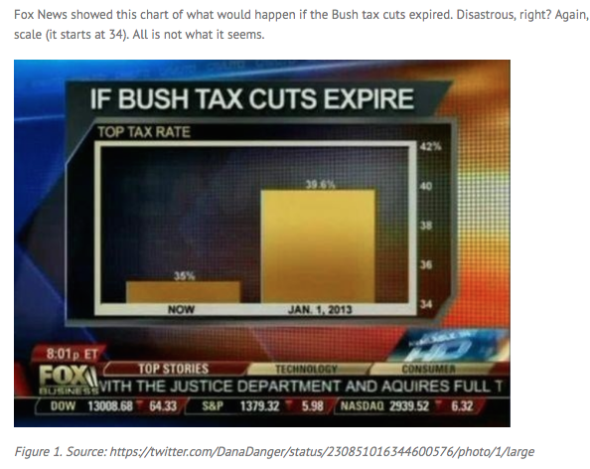

Slide 32
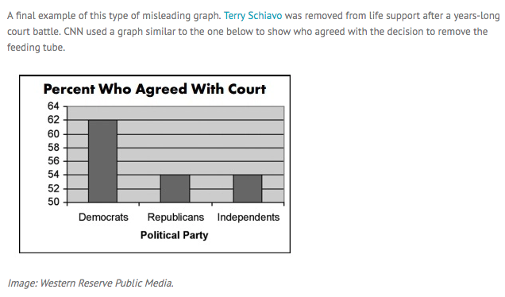

Slide 33
To be able to make an ethical decision:
5. not operate in an atmosphere of ethical neutrality.

Slide 34
Modeling may help
Modeling is about decisions;
  recognizing when a decision is necessary
  making a decision
  revisiting decisions.
let students “drive” the discussion, “recognize” their own decision-making.
GAIMME (COMAP & SIAM)

Slide 35
What is mathematical modeling:
tackles big, messy, realistic problems.
helps students connect mathematics to life and empowers them to use their mathematics.
solves relevant problems that are hopefully important to our students.
GAIMME (COMAP & SIAM)

Slide 36
Warning on mathematical models!
  Paul Ernest University of Exeter (UK) in a recent issue of “The Philosophy of Mathematics Education Today” : singular focus on mathematics may lead to:
    ethical neutrality
    dehumanizing outlook
    cold numerical logic
    https://theweek.com/articles/785737/why-math-ethics-should-handinhand

Slide 37
Example: insurance rates
Kathy O’Neil Weapons of Math Destruction
“Often the person is so driven to solve the challenge , they become blinded to the ethical dilemma right in front of them.”
www.techpoweredmath.com/math-ethics-education/

Slide 38
But
Teaching mathematics through modeling can be done so that it is:
It is not “cold numerical logic.”
Does not promote “ethical neutrality.”
Does not train students to detach meaning from their emotional and intellectual lives.

Slide 39
A word problem for fourth grade:
Best Price gas costs $3.10 a gallon. The other gas station across the street charges $3.90 a gallon. How much will Paul save if he buys 15 gallons of gas in Best Price.

Slide 40
A modeling problem for fifth grade:
Gas prices change on a nearly daily basis, and not every gas station offers the same price for a gallon of gas. The gas station selling the cheapest gas may be across town from where you are driving. Is it worth the drive across town for less expensive gas?
Create a mathematical model that can be used to help understand under what conditions it is worth the drive.

Slide 41
So what are the considerations or issues in this problem?
Personal
Ecological

Slide 42
In conclusion
We must teach our future teachers well so that they in turn can give their students some of the tools to be able to make an ethical decision:
understand the argument.
recognize (and expect) logic in an argument.
have the confidence to question inconsistencies in an argument.
pick out the fallacies in the interpretation of data.
not operate in an atmosphere of ethical neutrality.

Slide 43
Thank you
patrice.tiffany@manhattan.edu

